Slide 1
Lecture 12 First-order Circuits (2)
Hung-yi Lee

Slide 2
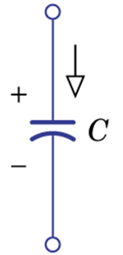
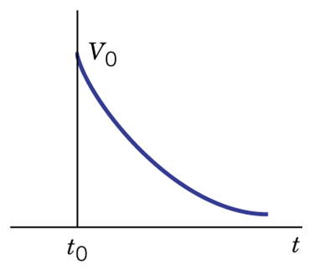
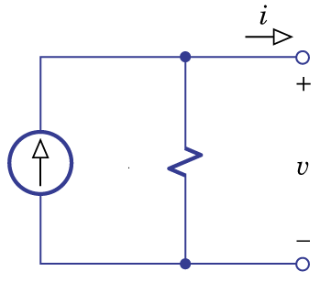
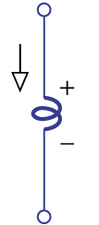
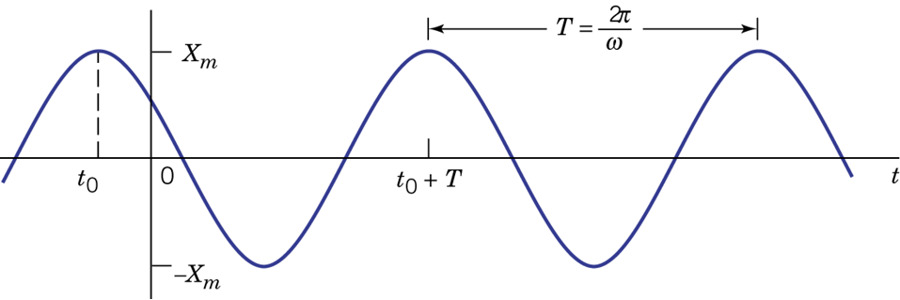
Outline
Non-constant Sources for First-Order Circuits (Chapter 5.3, 9.1)

Slide 3
Outline
Examples 5.12 and 5.11
Solved by Differential Equation
Solved by Superposition and State

Slide 4
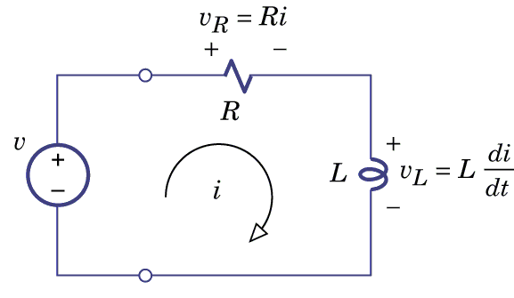
Example 5.12
RL circuit
R=4Ω, L=0.1H
Find i(t), t>0
i(t)=0, if t<0
(t>0)

Slide 5
Example 5.12 – Differential Equation
i_{N}(t): General solution (Natural Response)
i_{F}(t): Special solution (Forced Response)
Natural Response:
A determined by initial condition
NOT

Slide 6
Example 5.12 – Differential Equation
i_{N}(t): General solution (Natural Response)
i_{F}(t): Special solution (Forced Response)
Forced Response:
Table 5.3 (P222)
v(t)=
i_{F}(t)=

Slide 7
Example 5.12 – Differential Equation
i_{N}(t): General solution (Natural Response)
i_{F}(t): Special solution (Forced Response)
Forced Response:

Slide 8
Example 5.12 – Differential Equation
i_{N}(t): General solution (Natural Response)
i_{F}(t): Special solution (Forced Response)

Slide 9
Example 5.11 – Differential Equation
Change v(t)
i_{N}(t): General solution (Natural Response)
i_{F}(t): Special solution (Forced Response)
Natural Response:
Independent to the sources
This circuit always has this term.

Slide 10
Example 5.11 – Differential Equation
i_{N}(t): General solution (Natural Response)
i_{F}(t): Special solution (Forced Response)
Forced Response:
If the form for i_{F}(t) contains any term proportional to a component of the natural response, then that term must be multiplied by t.
P224 - 225

Slide 11
Example 5.11 – Differential Equation
i_{N}(t): General solution (Natural Response)
i_{F}(t): Special solution (Forced Response)
Forced Response:

Slide 12
Example 5.11 – Differential Equation
i_{N}(t): General solution (Natural Response)
i_{F}(t): Special solution (Forced Response)

Slide 13
Differential Equation - Summary
List differential equation and find initial condition (from the property of inductors and capacitors)
1. Find general solution (natural response)
Exponential form: Ae^{-λt}
Find λ
2. Find special solution (forced response)
Form: Consult Table 5.3 (P222)
If a term in special solution is proportional to general solution, multiplying the term by t
Find the unknown constant
3. Add the general and special solution together, and then find A in the general solution by initial condition

Slide 14
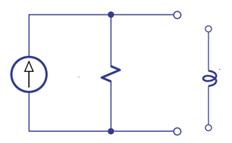
Example 5.12 – Superposition + State
RL circuits
R=4Ω, L=0.1H
i(t)=0, if t<0
Find i_{state}(t)
Consider the circuit from t=0
State is zero
No state term
Only input term

Slide 15
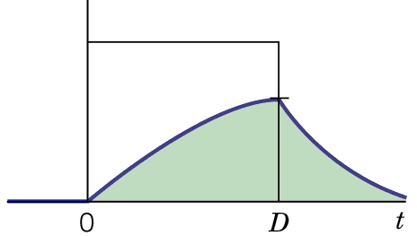
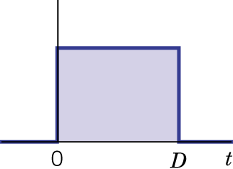
Example 5.12 – Superposition + State
Review: pulse response
If D is small
(If x is small)

Slide 16
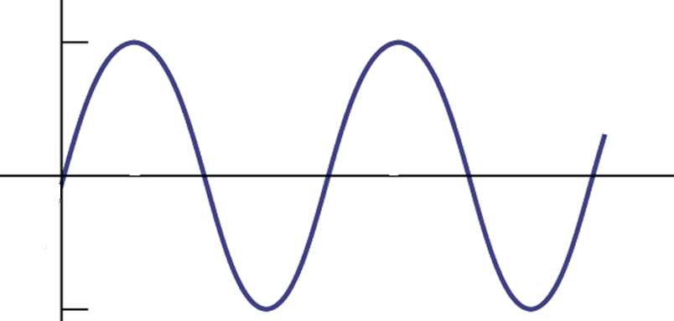
Example 5.12 – Superposition + State
……
The sin wav is composed of infinite tiny pulse!
Find the response of each tiny pulse and sum them together.
Notes:
draw

Slide 17
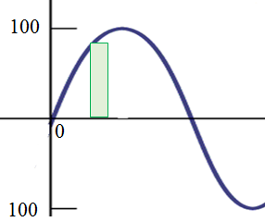
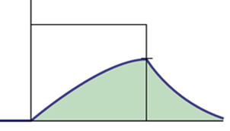
Example 5.12 – Superposition + State
Response of the pulse between time point t₀-Δt and t₀
Δt is small

Slide 18
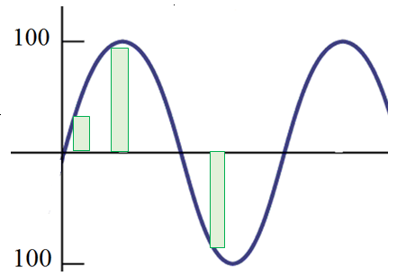
Example 5.12 – Superposition + State
The response of sin wave is the summation of all the pulse responses.

Slide 19
Example 5.12 – Superposition + State
Current Source
(Input)
Let’s focus on the response of sin wave at time point a
We do not have to care the pulse after time point a.
…
…
…
Current on Inductor
(Response)
…
…
The function is zero at point a

Slide 20
Example 5.12 – Superposition + State
Current on Inductor
(Response)
…
…
…
…
…
Value at a:
Notes:
Response depends on two things:
Distance and height

Slide 21
Example 5.12 – Superposition + State
Current on Inductor
(Response)
…
…
…
…
…
Value at a:

Slide 22
Example 5.12 – Superposition + State
RL circuit
R=4Ω, L=0.1H

Slide 23
Example 5.12 – Superposition + State
(P806)
We can always replace “a” with “t”.
Notes:
The same “t” has different meaning. Do you notice that?

Slide 24
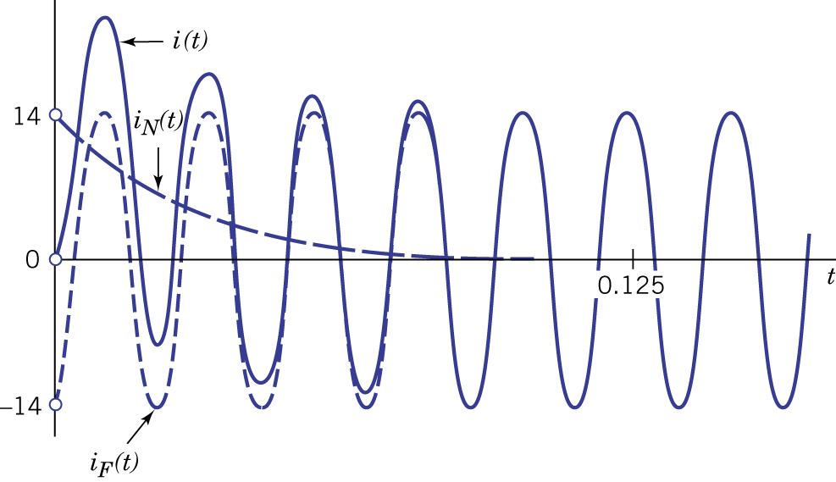
Example 5.12 – Superposition + State
Notes:
From superposition draw on the black broad

Slide 25
Example 5.12 – Superposition + State
From Differential Equation
If we have initial condition i(0)=V_{x}
From Superposition State
Superposition (no state)
State

Slide 26
Example 5.11 – Superposition + State
RL circuit
R=4Ω, L=0.1H
Find i(t)
i(t)=0, if t<0

Slide 27
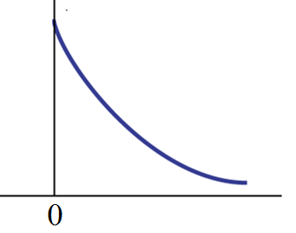
Example 5.11 – Superposition + State
Current Source
(Input)
Current on Inductor
(Response)
Response of the pulse between time point t₀-Δt and t₀
Its contribution at point a:

Slide 28
Example 5.11 – Superposition + State
For the response of the pulse between time point t₀-Δt and t₀
Its contribution at point a is:
Notes:
Real world

Slide 29
Homework
5.56
5.60
5.64

Slide 30
Thank you!

Slide 31
Answer
5.56: iF(t) =-10te^(-20t) - 3e^(-20t)
5.60: vF(t) = 2 – 50te^(-25t)
5.64: i(t) = 0.05e^(25t) + 0.02 – 0.07e^(-25t)

